Slide 1





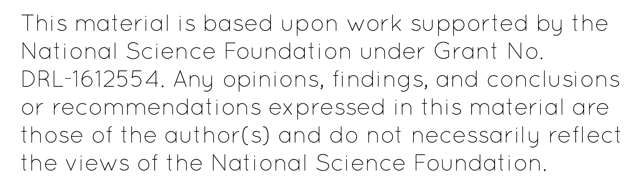
Analyzing Uranium Contamination in Rainwater from National Atmospheric Deposition Program sites
By: Jacob Henry
Notes:
General Criticisms:
Add in NSF - NADP write out - U concentration - Need both maps? - Citations - Lab prep – simplify – no need to mention TM since - Get rid of stats anal slide - Why are there two standards for water? - Need to write out the petrified forest outlier value - Retitle all figures - Hit 8 mintes at site by year slide - No need to show table slides - Remove ANOVA slide - Need a wrap up – thank you slide - Read papers from Alex for U elevated value by petrified forest - How many samples you analyzed by each site - Samples received by season - Went over by 2 min, 54 sec
Check the units and conversions

Slide 2
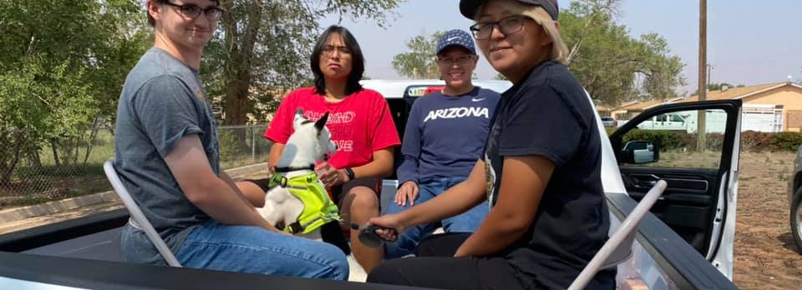
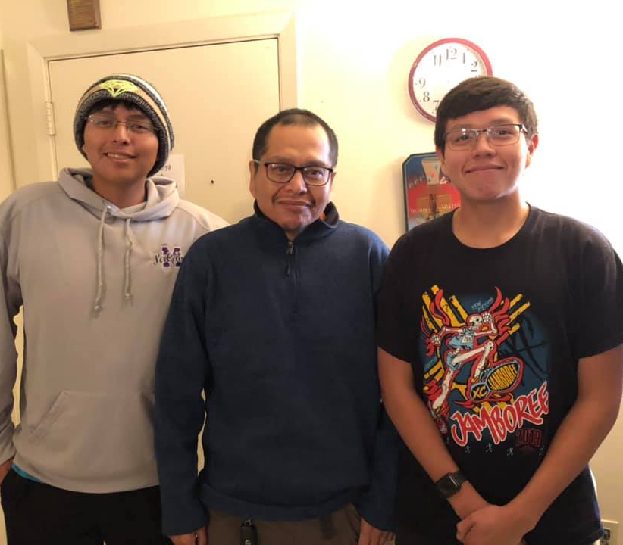

Positionality Statement
Born in Tuba City, AZ and spent a significant amount of my childhood growing up on the reservation
Learned about my community problems and shaped my perspective of inequality in America
What does it mean to be an Engineer?
Notes:
Changes:
Put images

Slide 3

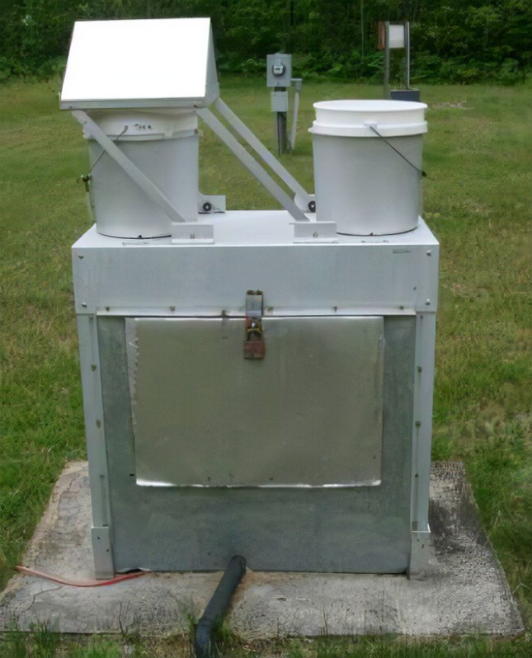
Introduction
The goal of the project was to explore and obtain a better understanding of Uranium concentration observed in rainwater at the National Atmospheric Deposition Program (NADP) sites in Arizona
Source: https://www.nrs.fs.fed.us/ef/marcell/generalinfo_pages/instrumentation/NADP_wetdry/
Notes:
Changes:
Picture rainwater water collector

Slide 4
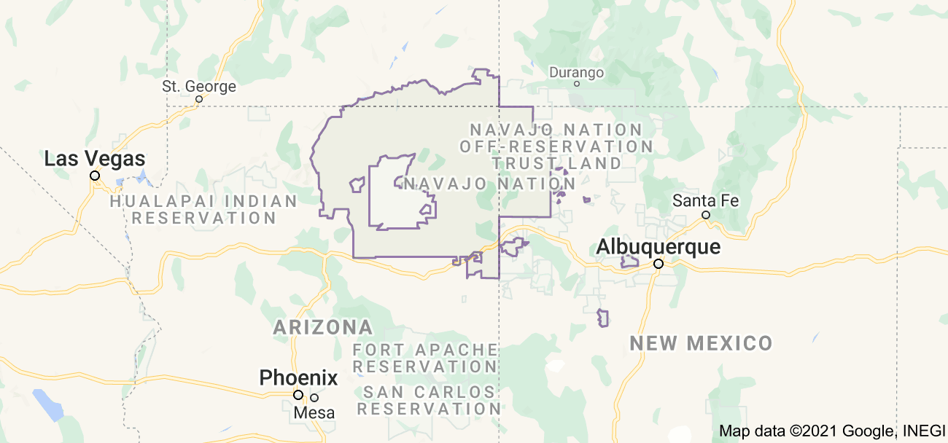
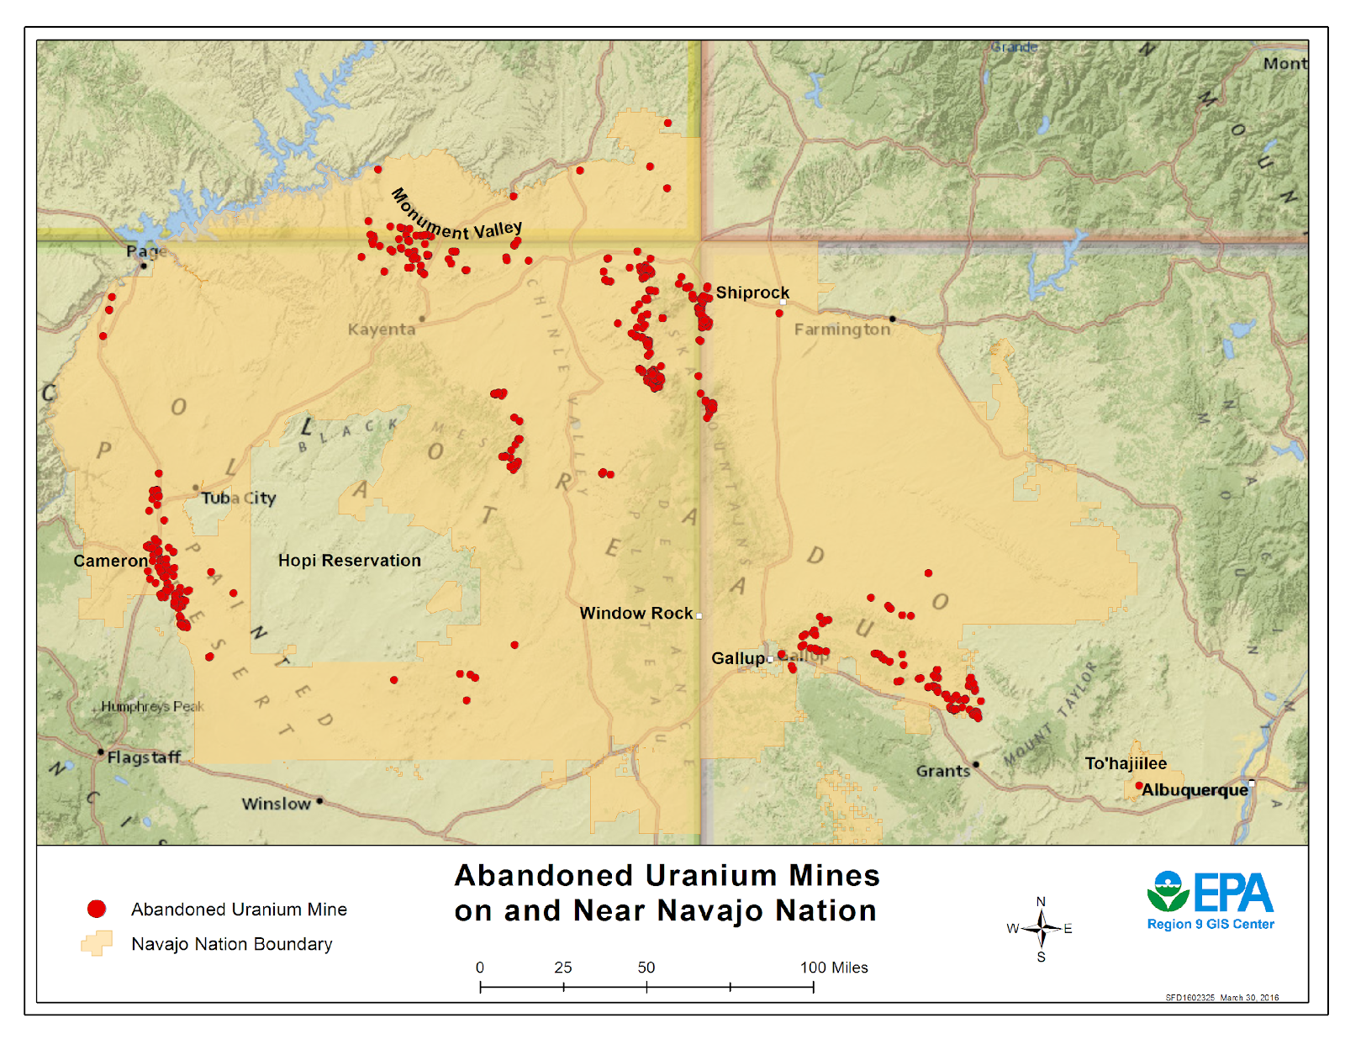
History of Uranium Mining
1948 – 1956
Produced 32 million pounds of uranium oxide
523 abandoned uranium mines (EPA)
Contaminated underground water sources due to mining
  Uranium
  Arsenic
In 2020 about 40% of homes do not have running water (Credo, et al., 2019)
Navajo Citizens still gather and haul water from unregulated water sources (i.e. aquafers and windmills) (Ingram, et al., 2020)
Notes:
Changes:
Divide this slides into History of Uranium mining
Move Health data to another slide titled Uranium health effects
Add Citations in very small text of the slide and add citation slide
Do intext citation or foot note it

Slide 5

Health Effects of Uranium Mining
Health problems
2.1 times more likely to pass away from kidney cancer
7.2 times more likely to pass away from gallbladder cancer
4.4 times more likely to pass away from stomach cancer
(Source for three statistics: Cancer Among Navajo 2018 Spread.pdf (navajo-nsn.gov))
Navajo Citizens were not warned of the threats that Uranium poses (Nelkin, 1981. pg. 6)

Slide 6
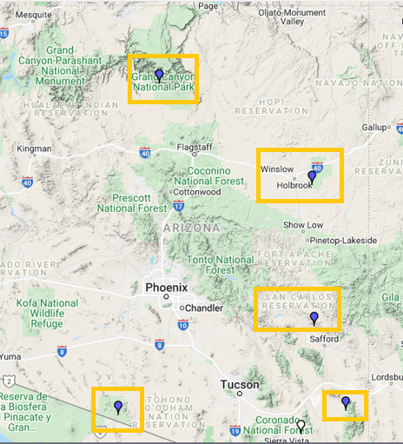
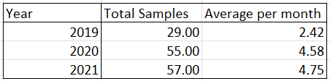
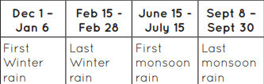
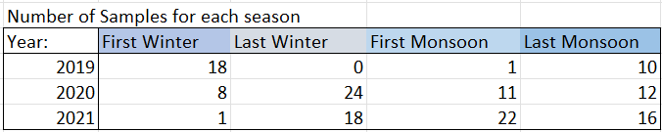
Sampling and Field Procedure
Rainwater samples collected from the years of 2019-2020 were gathering from NADP sites Chiricahua, Grand Canyon, Oliver Knoll, Organ Pipe, and Petrified Forest using a mechanized rainwater catchers
Source: MasterChecklist11X12FINAL (arizona.edu)
Source: https://nadp.slh.wisc.edu/maps-data/ntn-interactive-map/
Notes:
Changes:
Make a table of samples gathered at each of these site by year and season
How many samples you analyzed by each site
- Samples received by season

Slide 7
Laboratory Preparation
Then these samples were digested with nitric acid to determine Dissolved Metals (DM)
Sample were analyzed through ICP MS (Clarify Acronym) for Uranium concentrations found in the rainwater sample to be analyzed
Notes:
Only did the dissolved metals for the data set

Slide 8
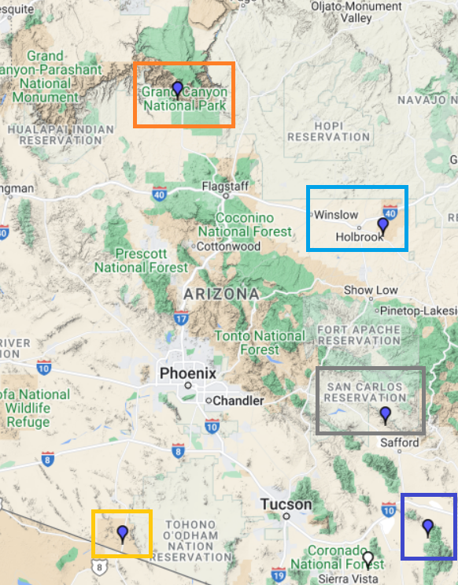
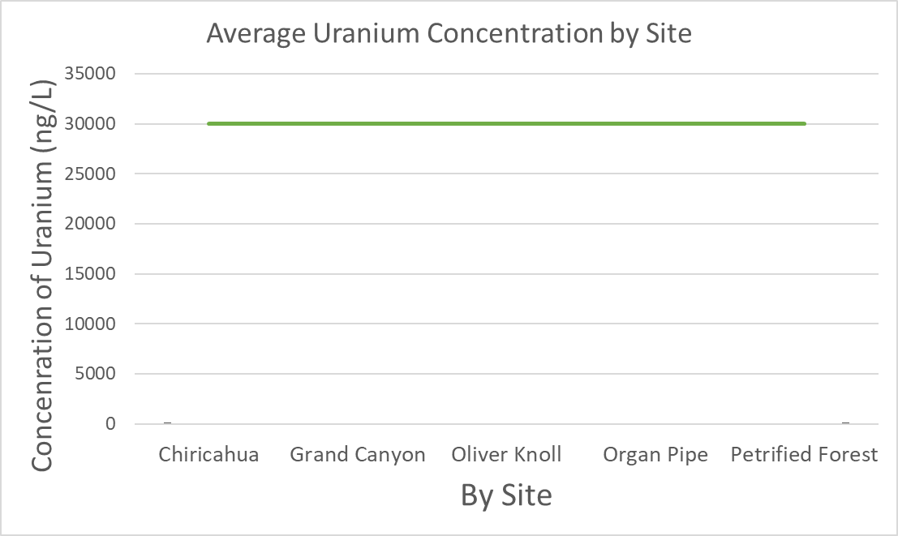
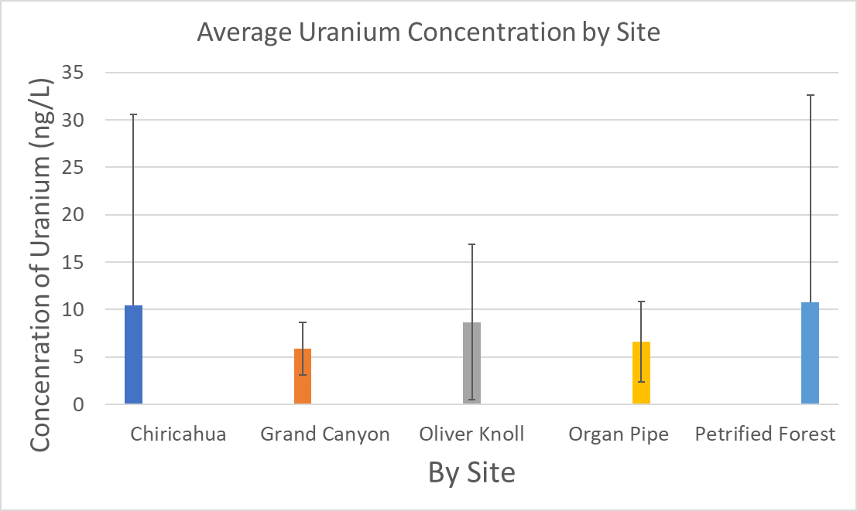
Results: By Site
Notes:
Changes:
Take out the “w/o Data Point”
Make the figure bigger
Change the squares to match the site colors on the graph
Write “removed outlier”

Slide 9
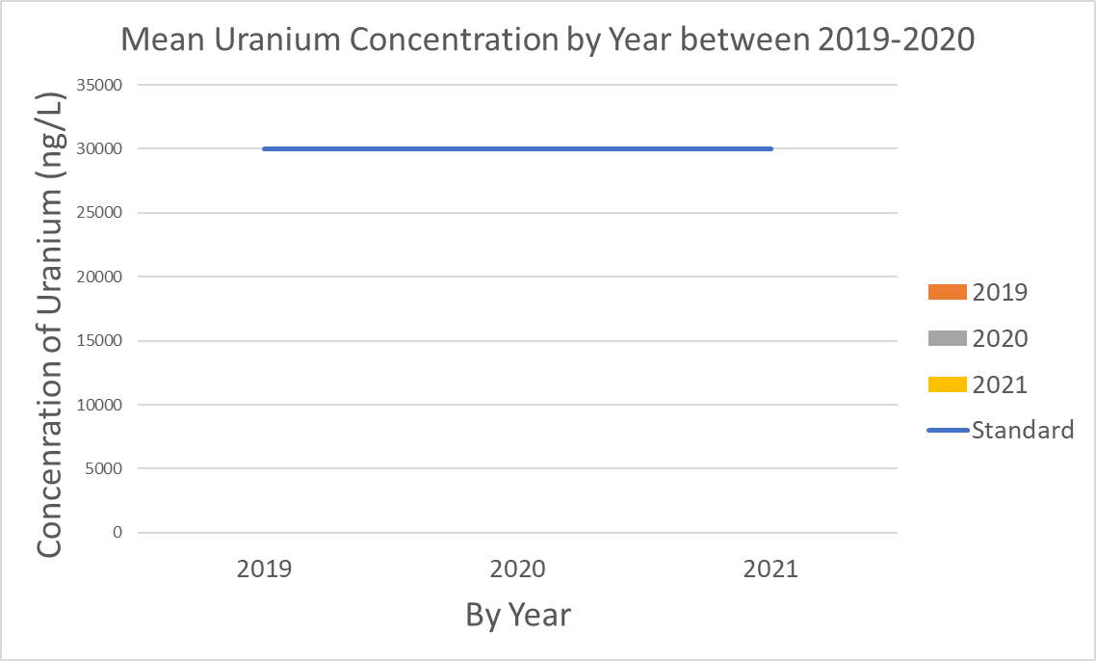
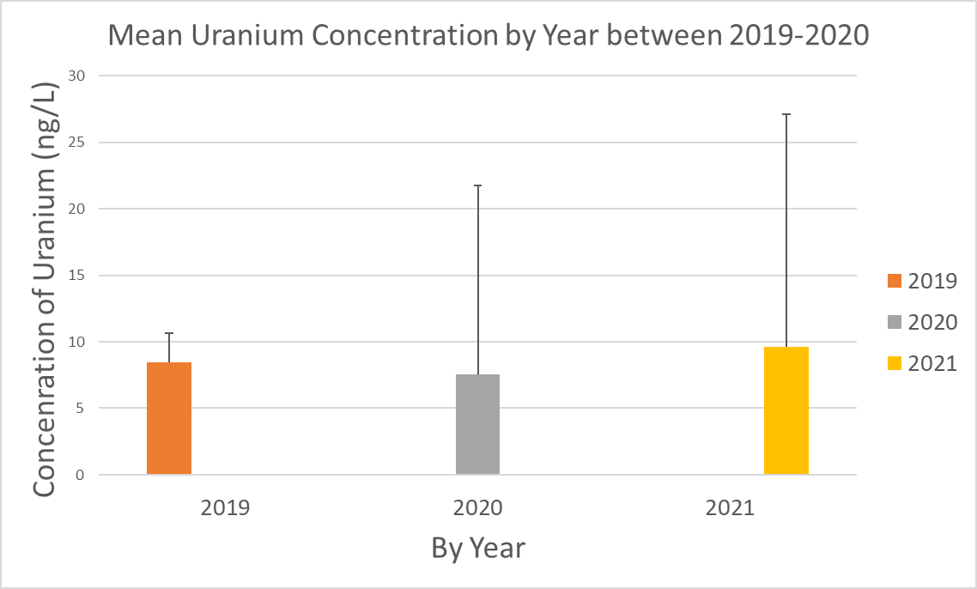
Results: By Year
Notes:
Sample size:
Sample varying in distribution due to the seasons
Take out the “w/o Data Point”
Make the figure bigger
Write “removed outlier”

Slide 10
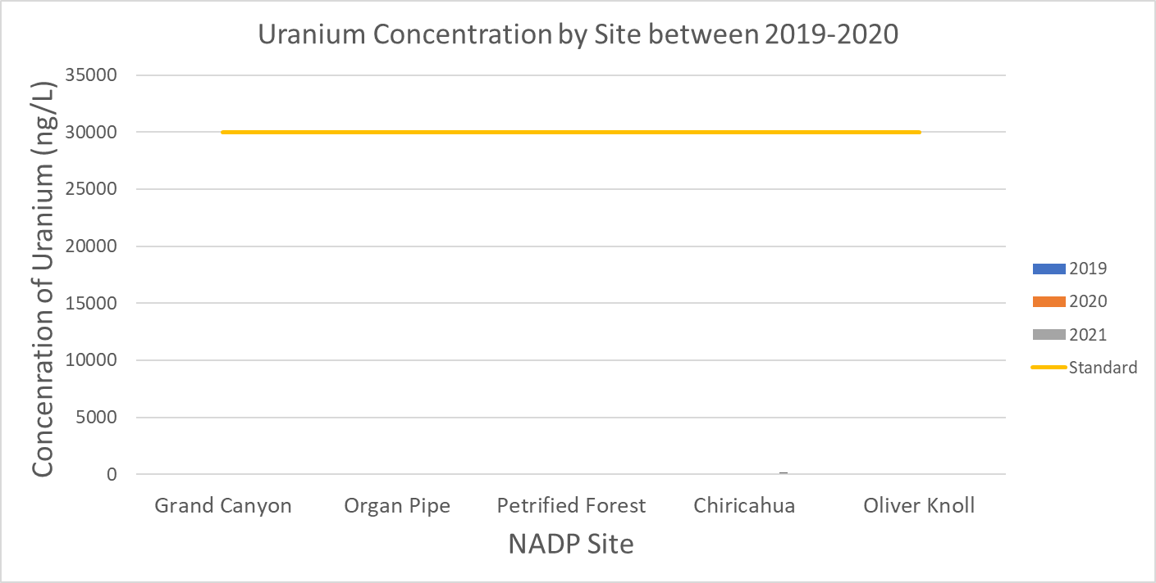
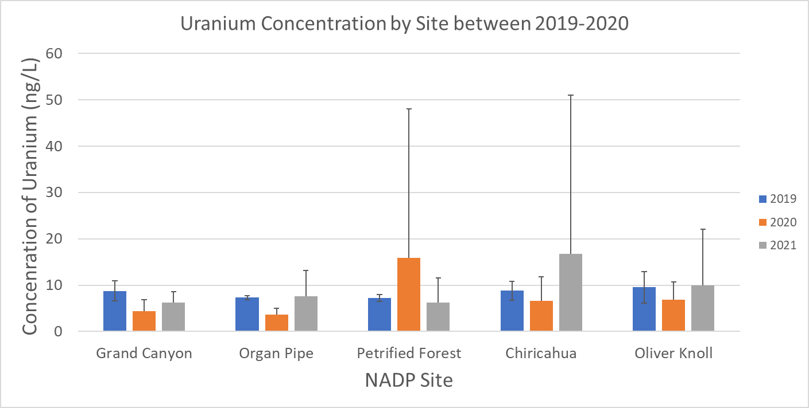
Results: By Site and Year
Notes:
Changes:
Take out the “w/o Data Point”
Make the figure bigger
Write “removed outlier”

Slide 11
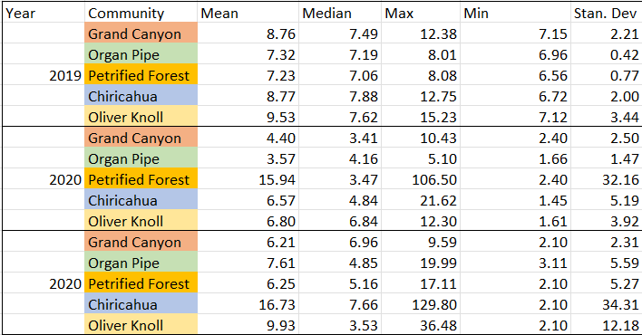
Results: Table
Notes:
Changes:
Pay attention to sig figs

Slide 12
Uranium Standards
Maximum Uranium Concentration (EPA drinking water standard):
  30 μg/L or 30000 ng/L
U standards for irrigation, livestock/poultry, partial body, full body, drinking according to Arizona Statutory Law
  Full Body Contact 2800000 ng/L
  Partial Body Contact 2800000 ng/L
  Drinking water 30000 ng/L
  Agriculture Irrigation None
  Agriculture Livestock None
No samples exceeded the standards
Notes:
Change
Citation for the U standards for the Irrigation, livestock, etc.
Blend this into the data slides
-think about how you can show this as a comparison of the analysis with the standard
Fix Uranium standards in ng/L and know if there were exceedances in the rainwater

Slide 13
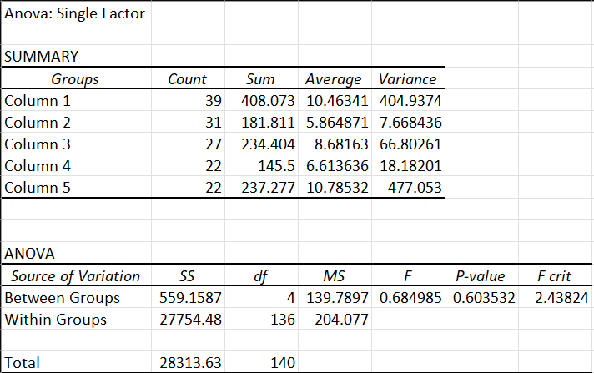
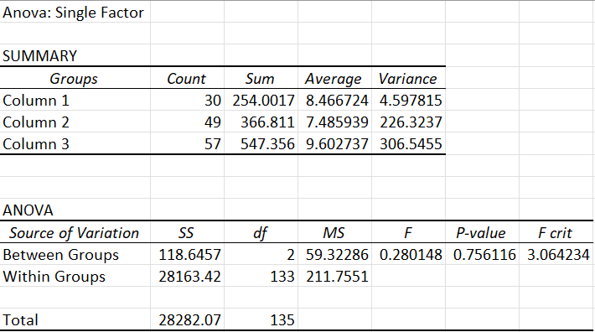
Results: Anova Results
Anova by Site:
Anova by Year:
Notes:
Thoughts:

Slide 14
What does this all mean
Based on the fact that the Anova test gave a p-value greater than 0.05 shows that there is no significance behind the data set and causes
Still lingering amount of Uranium in the rainwater sample
Data Point from Petrified Forest from September 9th, 2020 is concerning
This is just one aspect of Uranium Contamination: Ground water, irrigation, lifestock, etc.
Notes:
Talk about why uranium concentration is still an issue even though there is no significance
Other media possible
Look at the

Slide 15

Thank you!

Slide 16
References
Credo, Jonathan, et al. “Quantification of Elemental Contaminants in Unregulated Water across Western Navajo Nation.” International Journal of Environmental Research and Public Health, vol. 16, no. 15, 2019, p. 2727. Crossref, www.mdpi.com/1660-4601/16/15/2727/htm#.
Ingram, Jani C, Lindsey Jones, Jonathan Credo, Tommy Rock, and Univ Arizona, Coll Med, Clin Translat Sci. "Uranium and Arsenic Unregulated Water Issues on Navajo Lands." Journal of Vacuum Science & Technology. A, Vacuum, Surfaces, and Films : An Official Journal of the American Vacuum Society (2020): Journal of Vacuum Science & Technology. A, Vacuum, Surfaces, and Films : an Official Journal of the American Vacuum Society. Web.
https://www.epa.gov/navajo-nation-uranium-cleanup/providing-safe-drinking-water-areas-abandoned-uranium-mines
https://www.nec.navajo-nsn.gov/Portals/0/Reports/NN2010PopulationProfile.pdf
Hoover, Joseph, et al. “Elevated Arsenic and Uranium Concentrations in Unregulated Water Sources on the Navajo Nation, USA.” Exposure and Health, vol. 9, no. 2, 2016, pp. 113–24.
Hoover, Joseph H., et al. “Spatial Clustering of Metal and Metalloid Mixtures in Unregulated Water Sources on the Navajo Nation – Arizona, New Mexico, and Utah, USA.” Science of The Total Environment, vol. 633, 2018, pp. 1667–78. ScienceDirect, www.sciencedirect.com/science/article/pii/S0048969718306880.
Cancer Among Navajo 2018 Spread.pdf (navajo-nsn.gov)
D. Nelkin, "Native Americans and Nuclear Power," Sci. Technol. Human Values, 6, No. 2, 2 (1981).

